Slide 1

Joe Day, Shelby Mahaffie, Sherry Shenker
CMSC 122 Winter 2016

Slide 2
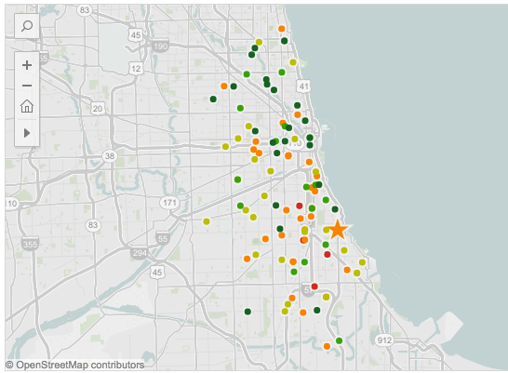
Problem
Source: Illinois Network of Charter Schools

Slide 3
Goals
Create a tool that empowers parents, students, and educators and leverages the advantages of an extensive school choice system
Key focuses:
Ease of use
Custom results
Data transparency

Slide 4
Algorithm overview

Slide 7
Up Close: Ranking Schools
Score for each school is based on...
Mean ACT score, college enrollment and persistence, freshman-on-track rate
Distance to school
Difficulty score if applicable
Calculate student’s tier
Calculate student’s “points” based on academic history and CPS “formula”
Calculate difficult score based on student’s “points” and historic points needed
Student priorities (academics vs. transit)
Return top 12

Slide 8
Challenges
Future Goals
Standardizing data
Missing data
Addresses
Learning a lot of different tools (GoogleMaps, Javascript, Selenium)
Details and comparison of select schools
Users have an account
More school-level information and searchability

